Slide 1
lol… not really ¯\_(ツ)_/¯
I
Concurrency
December 2014

Slide 2
Agenda
Fundamental operation types
Concurrency
Threads
Asynchronous programming
Multithreading programming
Parallel programming

Slide 3
Fundamental operation types

Slide 4
Fundamental operation types
First you must understand 2 kinds of operations in any application:
I/O-bound operations
CPU-bound operations
I/O-bound: are tied to an input or output device
User-interface peripheral: keyboard, mouse, touchpad
Non-memory durable storage: HDD, SSD
Network or communication port
CPU-bound: use the computer CPU to process intensive or repetitious computations (same piece of data AKA logically related / cohesive data)

Slide 5
Operation types
I/O-bound operations can take place with a CPU-bound operations
Accessing the disk (I/O-bound) to concurrently process an image (CPU-bound)
Two I/O-bound operations should access the same resource (disk, network socket, etc.)
CPU-bound excels in multi-CPU machines
Use extra processing power thru each CPU
Single-CPU machine offer no performance advantage

Slide 6
Must know the difference
Concurrency vs Thread vs Multithreading?
Different programming techniques
Concurrency:
Thread:
Multithreading:
Asynchrony:

Slide 7
Must know the difference
Concurrency vs Thread vs Multithreading?
Different programming techniques
Concurrency: Doing more than one thing at a time
Thread: is a path of execution within a process
Multithreading: is a form of concurrency that uses multiple threads of execution
Asynchrony: is a form of getting concurrency without multi-threading

Slide 8
Concurrency

Slide 9
Concurrency
Doing more than one thing at a time
Enables several programming models
Asynchronous programming
I/O-bound
Multithreading programming
CPU-bound
Parallel processing

Slide 10
Concurrency…
Concurrency
Multithreading programming
Task.Run (…)
Asynchronous programming
async / await
Parallel
programming
Parallel.ForEach(…) / PLINQ

Slide 11
Threads

Slide 12
Thread
Q: What is a process?
Q: What it is a thread?

Slide 13
Thread
Q: What is a process?
A process is an executing program.
An OS uses processes to separate the applications that are being executed
Q: What it is a thread?
A thread is a path of execution within a process
In .NET a thread is the basic unit of execution in which an OS allocates processor time

Slide 14
Thread
A process is an executing program
An OS uses processes to separate the applications that are being executed
A thread is a path of execution within a process
In .NET, a thread is the basic unit of execution in which an OS allocates processor time
Managed code of the underlying OS threads

Slide 15
Thread
Every application runs on at least one thread
Initialized when the app is started up
Can have multiple threads
Always execute in the context provided by the application process

Slide 16
Thread
For each thread, the OS allocates:
Registers
Program counter
Stack and a stack pointer
Assigns a time slot
Priority

Slide 17
Thread
The OS is responsible for:
Scheduling
Context switching
Thread manipulation requests
Start, sleep, cancel, etc.

Slide 18
Thread
In .NET exposes
Native thread properties (e.g., priority)
State
Exception handlers
Security principal
Name
Unique ID
Culture

Slide 19
Thread
System.Threading
Thread → CurrentThread

Slide 20
More on threads
Create and associate
Block, Suspend and Resume, Joining, Interrupting, Aborting, Check for state
Putting to sleep, wait for
To die (terminate)
To complete
Synchronization → Race condition
T1 needs another T2 to complete a task or reach a certain state
Developers often misuse

Slide 21
More on threads
Priority and Scheduling
Each thread is allocated a fixed time slot to run on the CPU and assigned a priority
Each thread is either ready to run or waiting for some event to occur
A synchronization object being signaled or a sleep timeout elapsing.
The OS schedules threads based on status and priority
Multiple threads ready with the same priority get go by round-robin

Slide 22
More on threads
Thread-safe: to incorporate mechanisms that prevent multiple threads from simultaneously accessing its methods and corrupting its state
Adding/Removing items of a list
Always strive for immutable state
Thread affinity: A resource always accessed by the same thread

Slide 23
Asynchronous programming

Slide 24
Asynchronous programming
Freeing up the calling thread instead of blocking
While I/O-bound operation is in progress
Do not consume CPU resources
Server
Release the request thread to gain Scalability
Client
Release the UI thread to provide Responsiveness

Slide 25
Asynchronous programming
Misconceptions
Does not create new threads
Does not use/schedule on the Thread-pool
Task type use when async/await != Task type in Parallel

Slide 26
Asynchronous programming
Relates to current and previous programming models
TAP → Task-based asynchronous pattern (current)
async / await
Task<T>
EAP → Event-based asynchronous pattern
void MyEventAsync( . . . ); EventArgs and EventHandler
Use of public asynchronous events and delegates (handlers)
APM → Asynchronous programming model
IAsyncResult
BeginInvoke( . . . )
EndInvoke( . . . )
Notes:
https://docs.microsoft.com/en-us/dotnet/standard/asynchronous-programming-patterns/

Slide 27
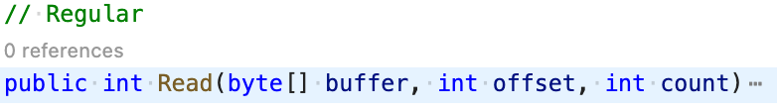
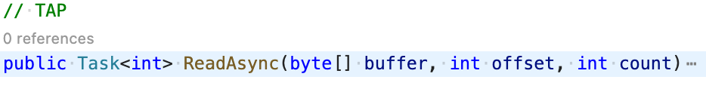
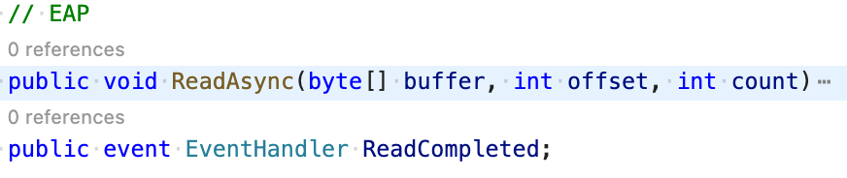
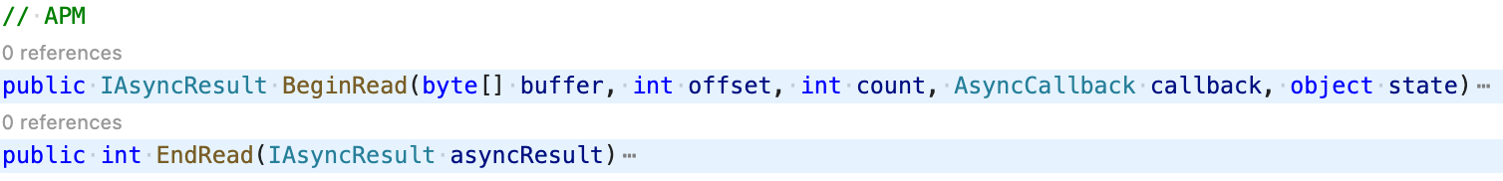
Asynchronous programming

Slide 28
Asynchronous programming
Asynchronous Programming
A form of concurrency that uses futures or callbacks to avoid unnecessary threads
Future (or Promise): is a type that represents some operation that will complete in the future
Task and Task<TResult>: modern programming model (TAP)
Callbacks and Events: legacy programming model

Slide 29
Asynchronous programming
Async & Await
Return type is Task and Task<T>
async void is only reserved for asynchronous event handlers
Always use Async as suffix. E.g., MyMethodAsync( . . . )
Again, the main idea is to be thread-less
There is no thread in the background waiting to come back
No threads are created
No threads should be used

Slide 30
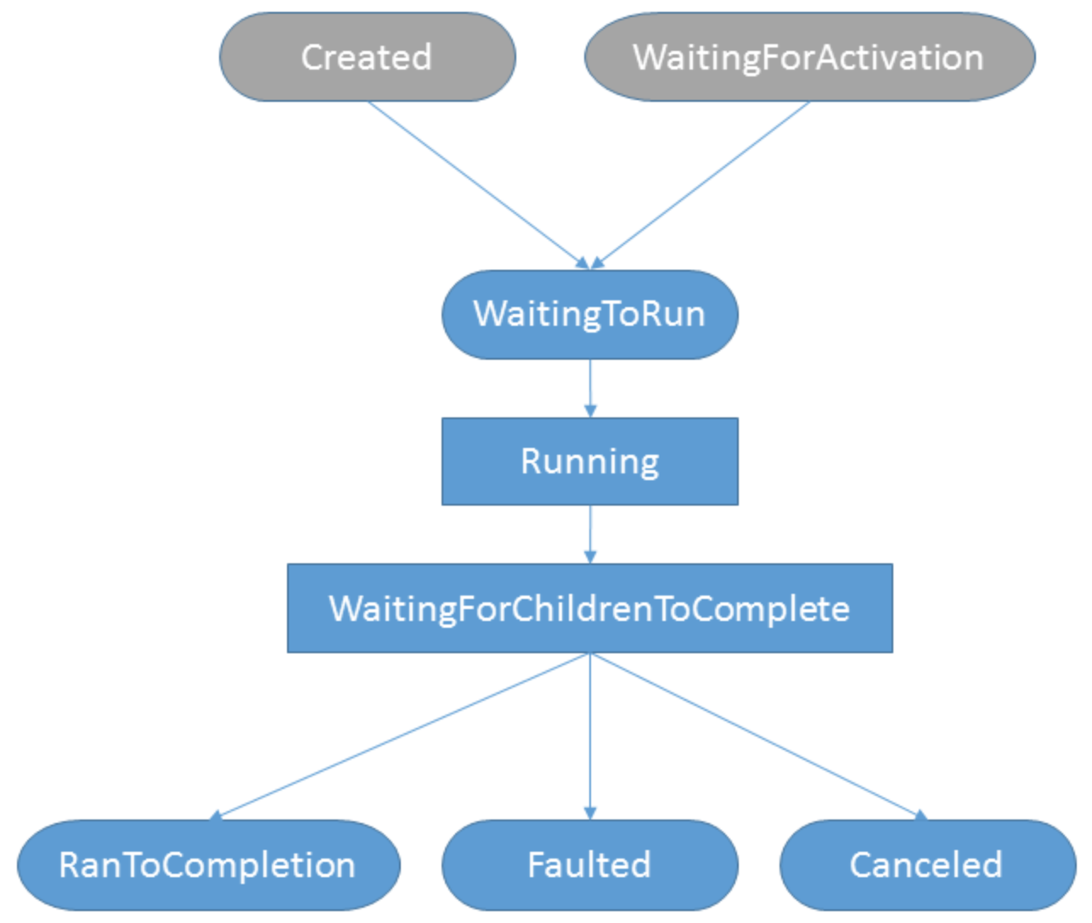
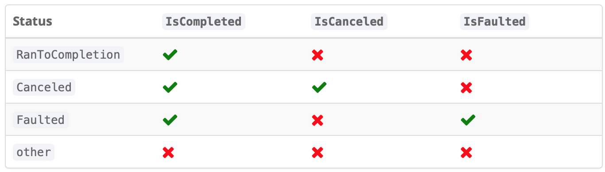
Asynchronous programming
Task and Task<T>
Possess and capture state
Can cancel
Support exceptions
Provide status of the task
Created
WaitingForActivation
WaitingToRun
Running
WaitingForChildrenToComplete
RanToCompletion
Canceled
Faulted
Final state of a task (mainly for debugging)
IsCompleted
IsCanceled
IsFaulted

Slide 31
Asynchronous programming
Async
Enables the use of await for the method
Transforms the method into a state machine
Does not run anything in a background thread
Await
An expression that takes an awaitable argument, Task or Task<T>
This awaitable represent an asynchronous operation
Will complete in the future (like a promise)
Will complete once (successfully, can complete with an exception or can be cancelled)
Observes the result of such Task (status and exception, if any)

Slide 32
Asynchronous programming
How async and await affect how the code executes?
Asynchronous methods start running synchronously
First, it check for the Task status, IsCompleted?
True
Extract the result of the Task
Continue the execution synchronously
False
Bookmarks the line of code to continue later
Pause the method, captures the context and returns an incomplete task to its caller

Slide 33
Asynchronous programming
Context is represented by the SynchronizationContext
Captured at the time of await

Slide 34
Asynchronous programming - Exercises
Instructions
Use a console application, unless indicated otherwise
Either .NET or dotnet core

Slide 35
Asynchronous programming - Exercises
Exercise – Declaring and Awaiting a task
Directly (await t;)
Using a Task variable (Task<T> myTask = AsyncMethod(); await myTask;)
Exercise - Tasks Error handling
Exercise - Declaring and consuming several tasks
Waiting for All to complete
Waiting for Any to complete
Discussion
Observe how exceptions behave

Slide 36
Asynchronous programming - Exercises
Exercise - Capture and inspect the Synchronization context
Capture and Ignore
Application types: console app, web mvc, web asp.net, winform, wpf
Exercise – Assess context continuation
When and when not to use ConfigureAwait(false)
Exercise – Task cancellation
Implementing a Cancellation Token

Slide 37
Asynchronous programming - Resources
Capture and assess the Synchronization context
* Asynchronous programming with async and await
Asynchronous programming
Task asynchronous programming model
References
The SynchronizationContext
Async Programming : Introduction to Async/Await on ASP.NET
Demystifying Async & Await in C#

Slide 38
Asynchronous programming - Resources
More about the HttpClient
Guidelines for using HttpClient
IHttpClientFactory with .NET
Make HTTP requests with the HttpClient class
References
Async/Await FAQ
Task Overview

Slide 39
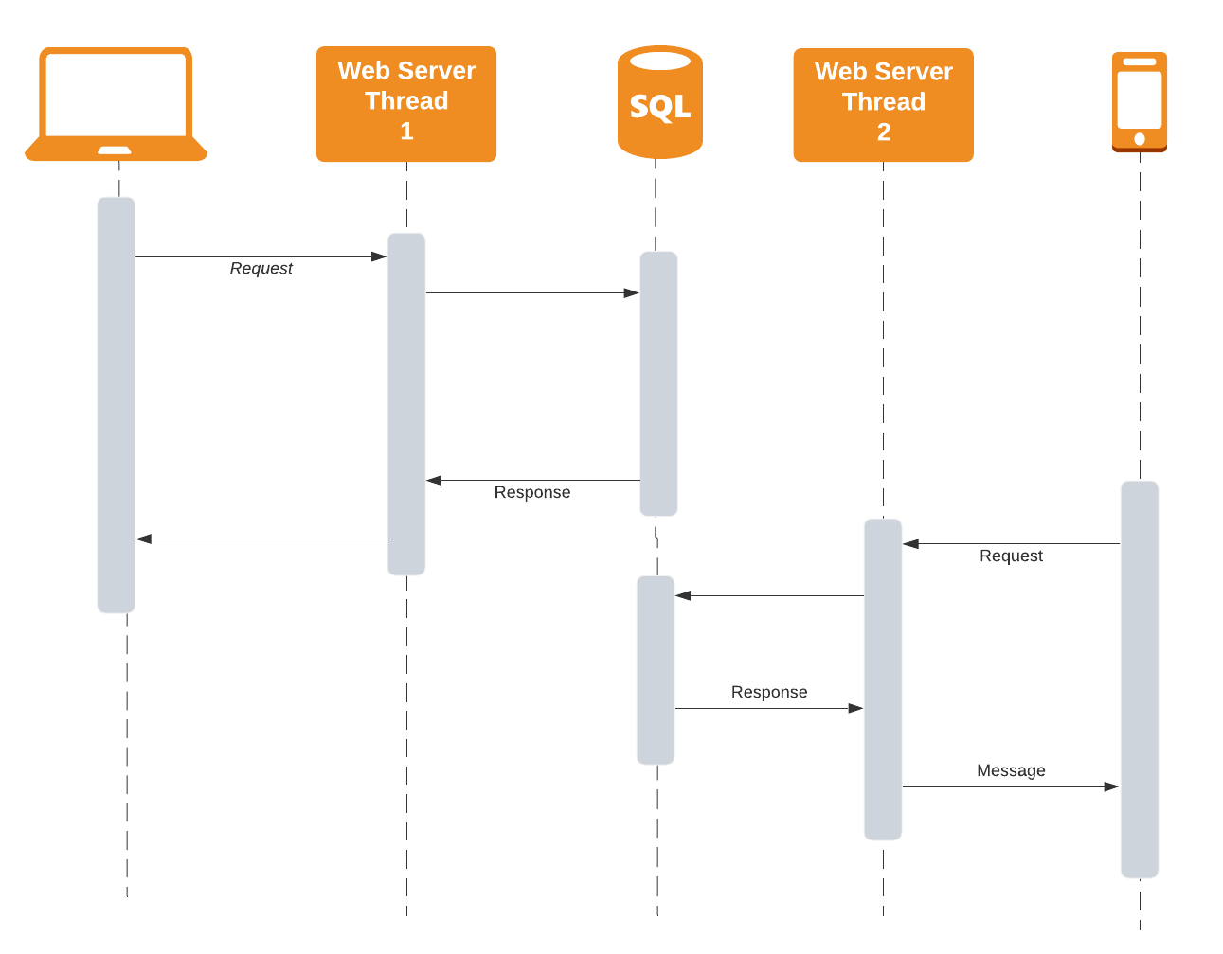
Asynchronous programming

Slide 40
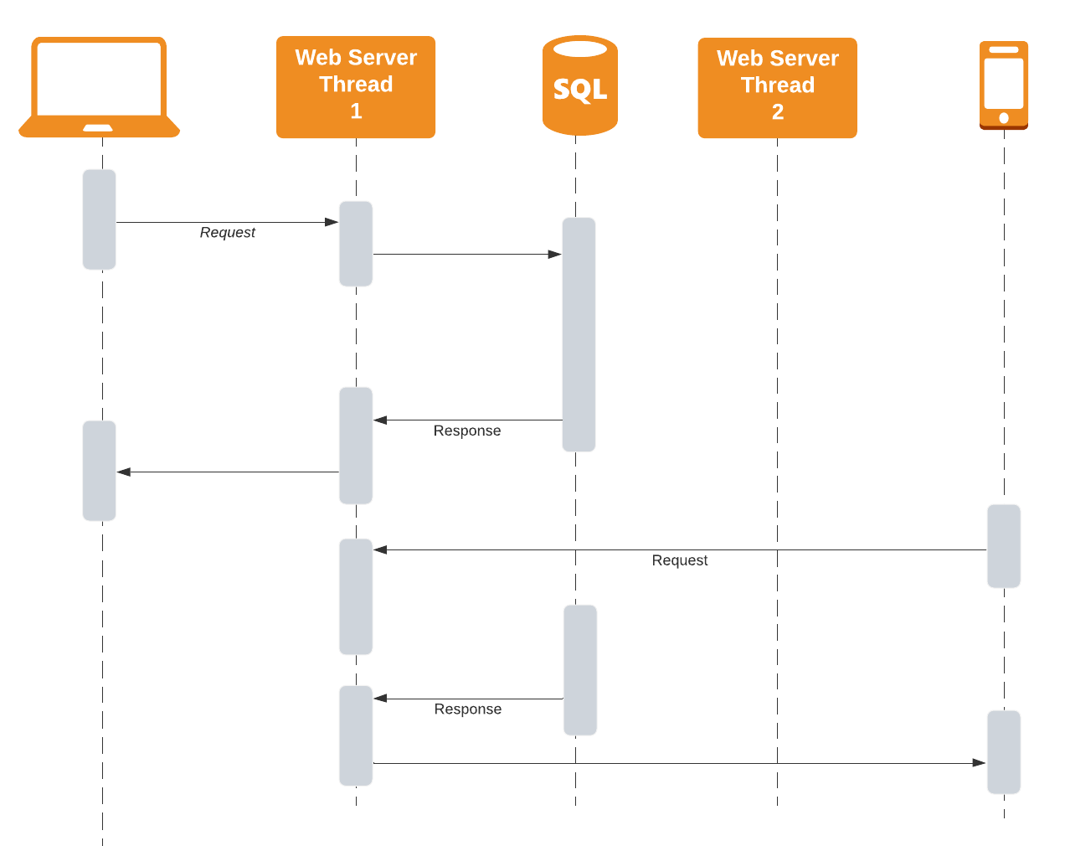
Asynchronous programming

Slide 41
Multithreading programming

Slide 42
Multithreading programming
Handle multiple requests using multiple threads
Enables one programming model of concurrency
Parallel processing
Most poorly understood and applied concepts in modern programming

Slide 43
Multithreading programming
Do not create multiple threads just for the sake of having them
Synchronization → Deadlock
Concurrency-management → Contesting for the same resources

Slide 44
Multithreading programming
Deadlock
Occurs when T1 owns a thread-safe resource R1, tries to access another thread-safe resource (R2) at the same time that a T2, which owns R2, tries to access R1
T1
T2
R1
R2

Slide 45
Multithreading programming
More topics to research on your own
Synchronization
Synchronization Domain
Synchronization Context
Application Domain
Available in .NET Core?
Foreground and background threads
Notes:
https://docs.microsoft.com/en-us/dotnet/core/porting/net-framework-tech-unavailable

Slide 46
Multithreading programming
Service-oriented applications inherently are CPU-bound
All operations get a dedicated thread of execution
Per-Call
Async & Await do not help here ☹

Slide 47
Multithreading programming
In .NET
Thread Local Storage (TLS)
Thread pool

Slide 48
Multithreading programming
Thread Local Storage (TLS)
Unique thread storage to an application domain
Is a thread-specific heap visible an accessible to all threads in the app domain
Mandates the use of the same thread
Require Thread affinity → to access the same TLS

Slide 49
Multithreading programming
TLS is useful to store
Contextual information
Transactions
Security information
Always marshalled correctly to the Synchronization Context
TLS can store objects in
Thread-relative static fields
Data slots

Slide 50
Multithreading programming
System.Threading.ThreadLocal<T>
Lazy<T> → deferred until initialized
LocalDataStoreSlot

Slide 51
Multithreading programming
Thread Pool
.NET-provided (and managed) threads can be worker threads
Nothing but pool of worker threads
Set of threads ready to serve application requests
Often used when the need is to dispatch a unit of work
Extensively used in .NET
There are 2 types
Worker threads (most applications interact with)
Completion port threads
Notes:
int workerThreads;
int completionPortThreads;
System.Threading.ThreadPool.GetMaxThreads(out workerThreads, out completionPortThreads);
int processorCount = System.Environment.ProcessorCount;
System.Threading.ThreadPool.GetMinThreads(out workerThreads, out completionPortThreads);

Slide 52
Multithreading programming
Worker threads
Task Parallel Library (TPL)
Asynchronous I/O completion
Timers
Completion Port threads
Network sockets

Slide 53
Parallel Programming

Slide 54
Parallel programming
Multithread
CPU-bound
Operations that are different in nature can be performed by the machine’s CPU or CPUs

Slide 55
I Concurrency
Q & A

